Slide 2
Minor Project – II Tech-Query Recommendation System
MEMBER’S NAME | ROLL NUMBER | SAP ID | BRANCH
Raghav Agarwal | R172219043 | 500076679 | Big Data
Rohan Saksena | R172219044 | 500077086 | Big Data
Preethi J | R172219069 | 500077820 | Big Data
Keshav Garg | R172219030 | 500076739 | Big Data
Under the guidance of
Dr. Tarandeep Kaur Bhatia
(Assistant Professor - SoCS)

Slide 3

Contents
Introduction
Motivation
Literature Review
Problem Statement
Objective
Methodology
Result and Discussion
Conclusion and future scope
Application of project
References

Slide 4
Introduction
A recommendation system in simple words is an algorithm that suggests relevant items to users.
Recommendation systems are really critical in some industries as they can become a means of high income.
Recommendation systems have taken more and more place in our lives.

Slide 5

Motivation
Sort massive amount of questions to identify interests of users and make information search easier.
To reduce time in debugging and solving queries of programmers.

Slide 6
Literature Review
In [1] the researchers covers different techniques which are used in recommendation systems and also proposes a new system for efficient web page recommendation which is based on hybrid recommendation which is a combination of K-mean algorithm and CHARM algorithm.
In [2] authors presented the overview of the challenges regarding to the techniques that are being used for generating recommendations and the ways we can improve the quality of recommendations
In [3] the researcher discussed the video recommendation system in use at YouTube and its challenges.
In [4] the paper discussed the challenges of providing recommendations in the domains where no sufficient historical data exist for measuring similarity between products or users and presented, present feature-based recommendation algorithms.

Slide 7
Problem Statement
To look for a system that would recommend the next query on the basis of present asked query.
To reduce the time spent on internet looking for solutions to tech - related queries (Time consuming).

Slide 8
Objective
A personalized information filtering technology used to identify a set of N items that will be of interest to a certain user.
To create a user-friendly environment where one can get answers to his tech-related queries.
To reduce the time a user spends on searching for answers to his queries.

Slide 9
Methodology
Data Collection / Extraction
Data Cleaning / Pre-Processing
Data Analysis and visualisation
Model Building
Dashboard

Slide 10
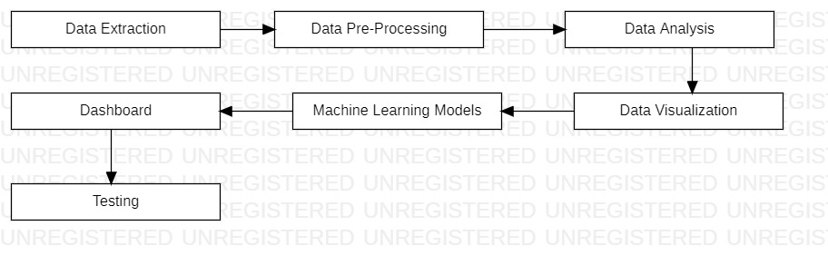
Fig 1: Plan of Work

Slide 11
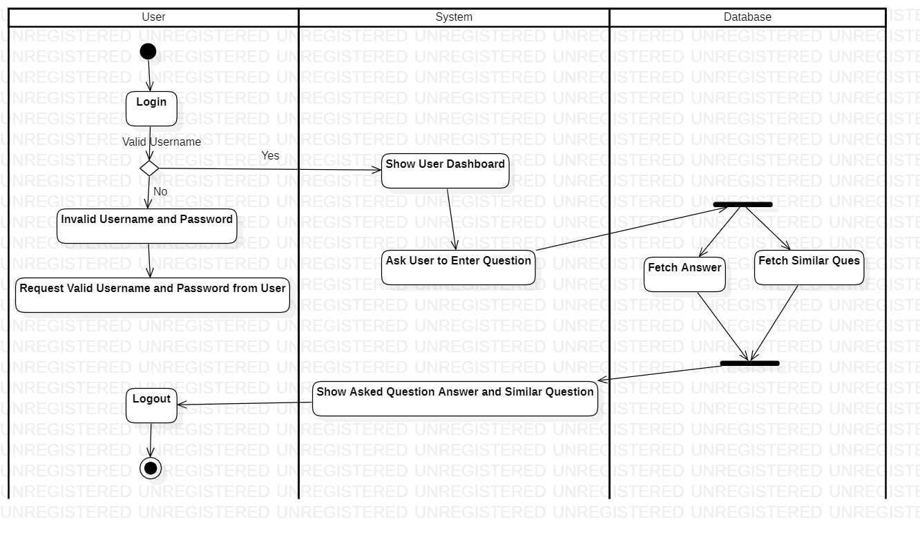
Fig 2: Activity Diagram

Slide 12
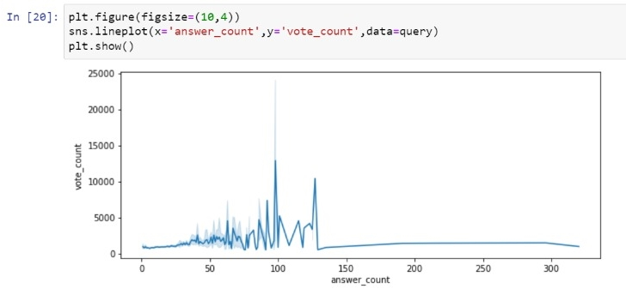
Screenshots

Slide 13
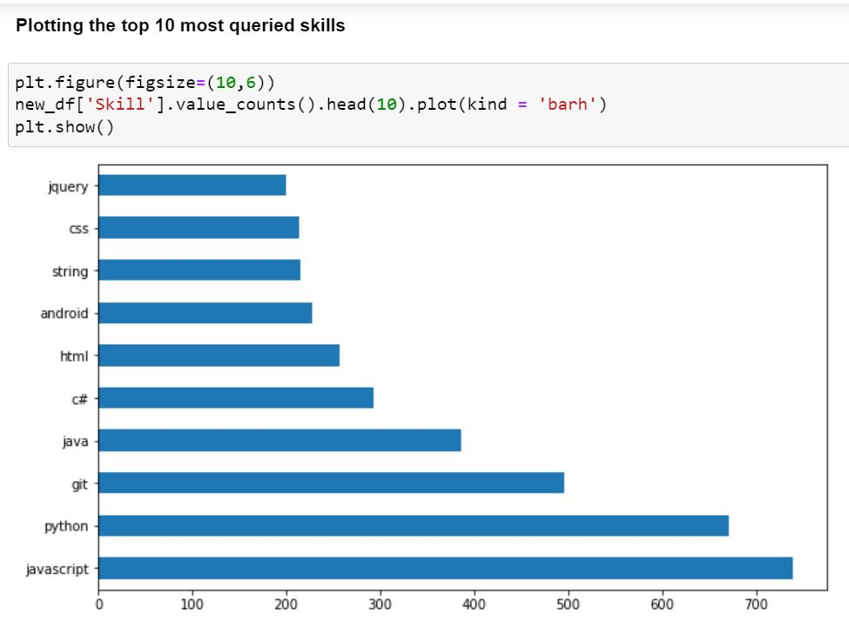

Slide 14
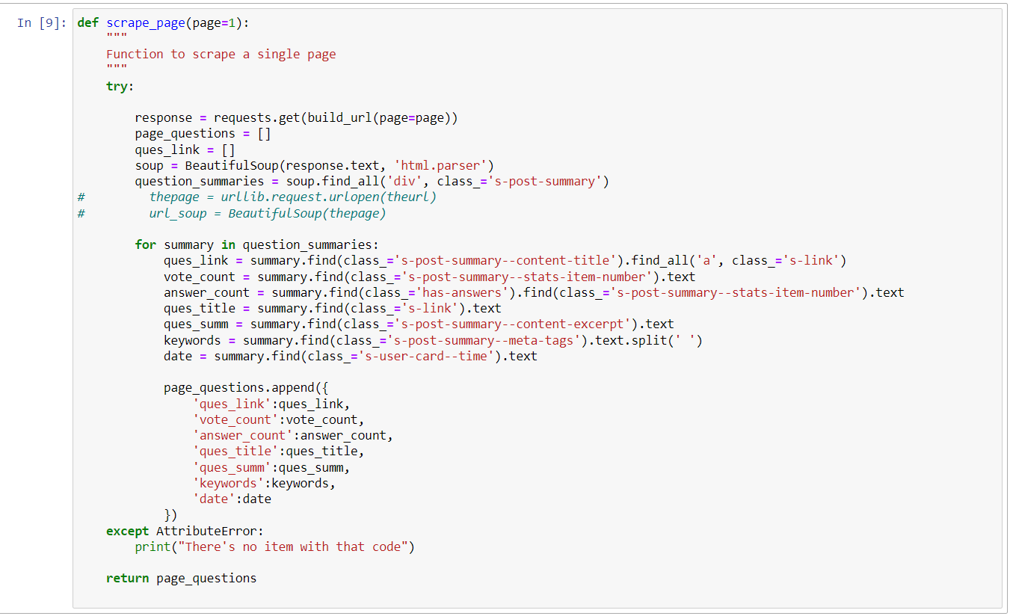

Slide 15
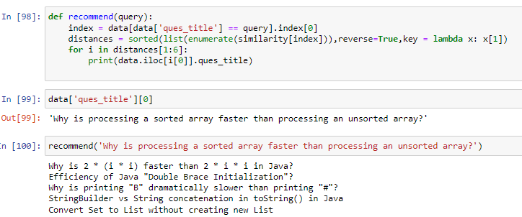

Slide 16


Slide 17
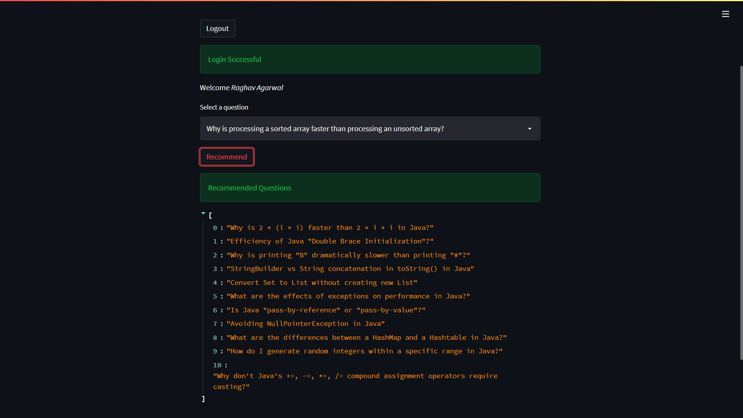

Slide 18
Result and Discussion
To extract the dataset from web resource and gain insights.
To build an efficient machine learn model that would not recommend the similar questions on the basis of historical data but on the basis of present interest using machine learning algorithms.
To create a user interface system where users enters their query and get the similar queries on the basis of asked query using steamlit.

Slide 19
Future Scope
Search history based recommendations
Recommendations based on real-time data

Slide 20
Conclusion
Analysing the extracted data from web source
Identified the dataset to be categorical data
text data can be converted into vector and perform KNN machine learning model for recommendation.

Slide 21
Application of Project
Enhance User Experience
Reduced Churn
Increased loyalty and share of mind

Slide 22
References
[1] Nagarnaik, P. and Thomas, A., 2015, February. Survey on recommendation system methods. In 2015 2nd International Conference on Electronics and Communication Systems (ICECS) (pp. 1603-1608). IEEE.
[2] Sharma, L. and Gera, A., 2013. A survey of recommendation system: Research challenges. International Journal of Engineering Trends and Technology (IJETT), 4(5), pp.1989-1992.
[3] Davidson, J., Liebald, B., Liu, J., Nandy, P., Van Vleet, T., Gargi, U., Gupta, S., He, Y., Lambert, M., Livingston, B. and Sampath, D., 2010, September. The YouTube video recommendation system. In Proceedings of the fourth ACM conference on Recommender systems (pp. 293-296).
[4]Han, E.H. and Karypis, G., 2005, October. Feature-based recommendation system. In Proceedings of the 14th ACM international conference on Information and knowledge management (pp. 446-452).

